Slide 1
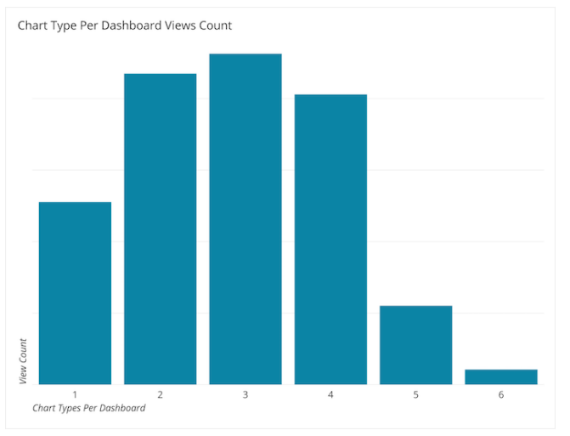
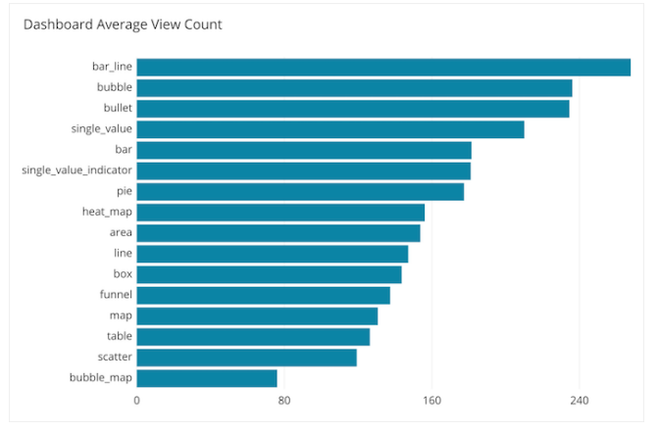
Not to do list
To create 3D plots.
To use more than 5 or 7 categories into a chart. (aggregate in others).
To use more than 4 types charts. (It is better to link the information)

Slide 2

Selecting the correct visualization
The most frequent visualization from most viewed dashboards

Slide 3
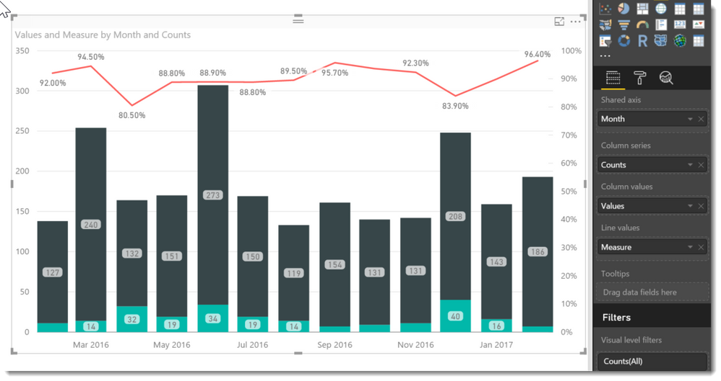
1. Bar line

Slide 4
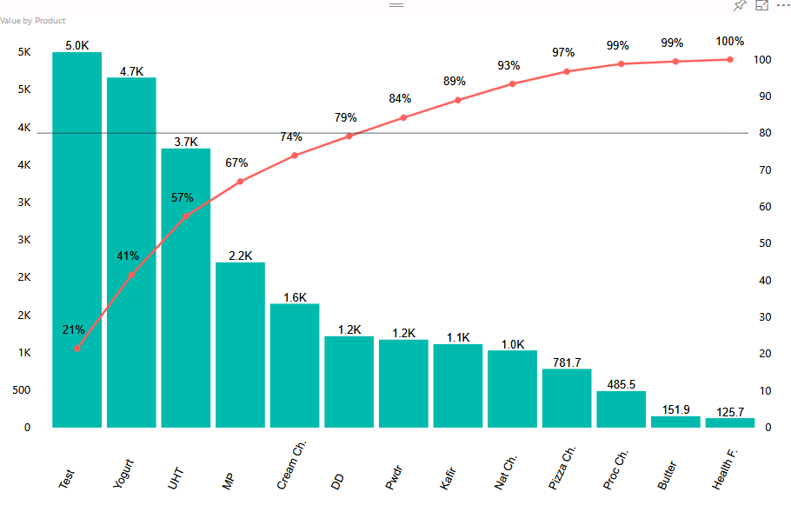
1. Bar line

Slide 5
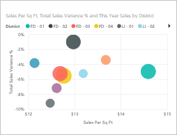
2. Bubble

Slide 6
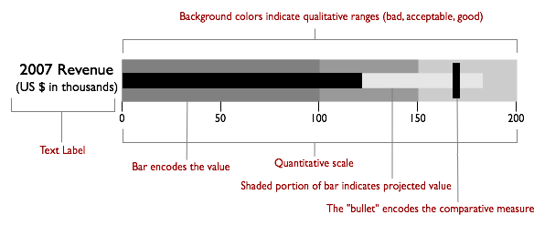
3. Bullet chart

Slide 7
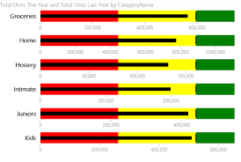
3. Bullet chart

Slide 8
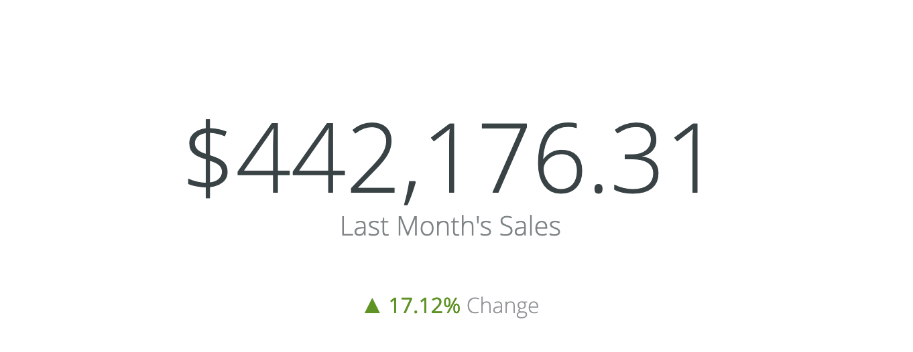
4. Single value

Slide 9
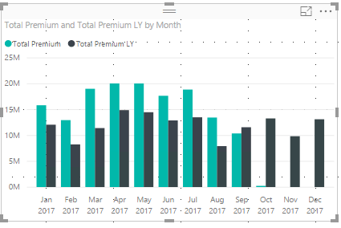
5. Bar

Slide 10
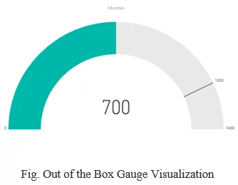
6. Single value indicator

Slide 11
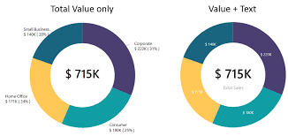
7. Pie

Slide 12
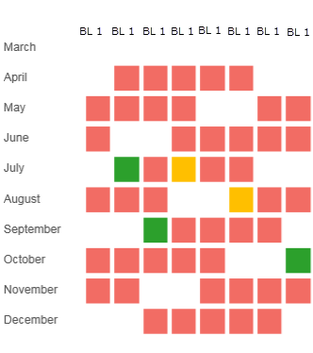
8. Heat map

Slide 13
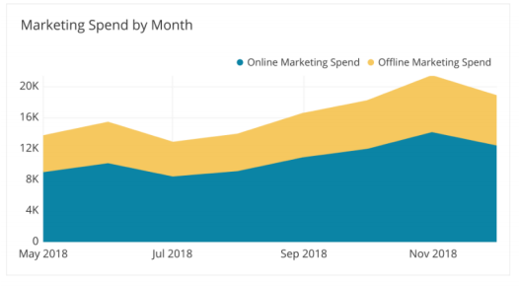
9. Area chart

Slide 14
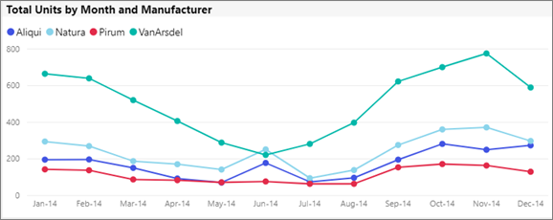
10. Line chart

Slide 15
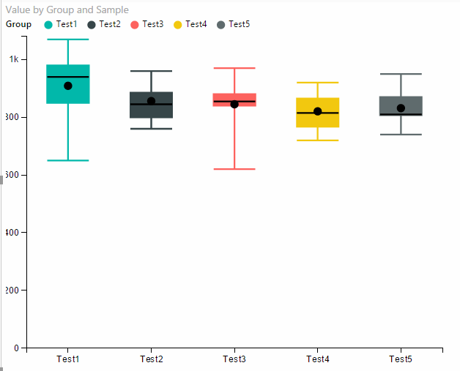
11. Box plot

Slide 16
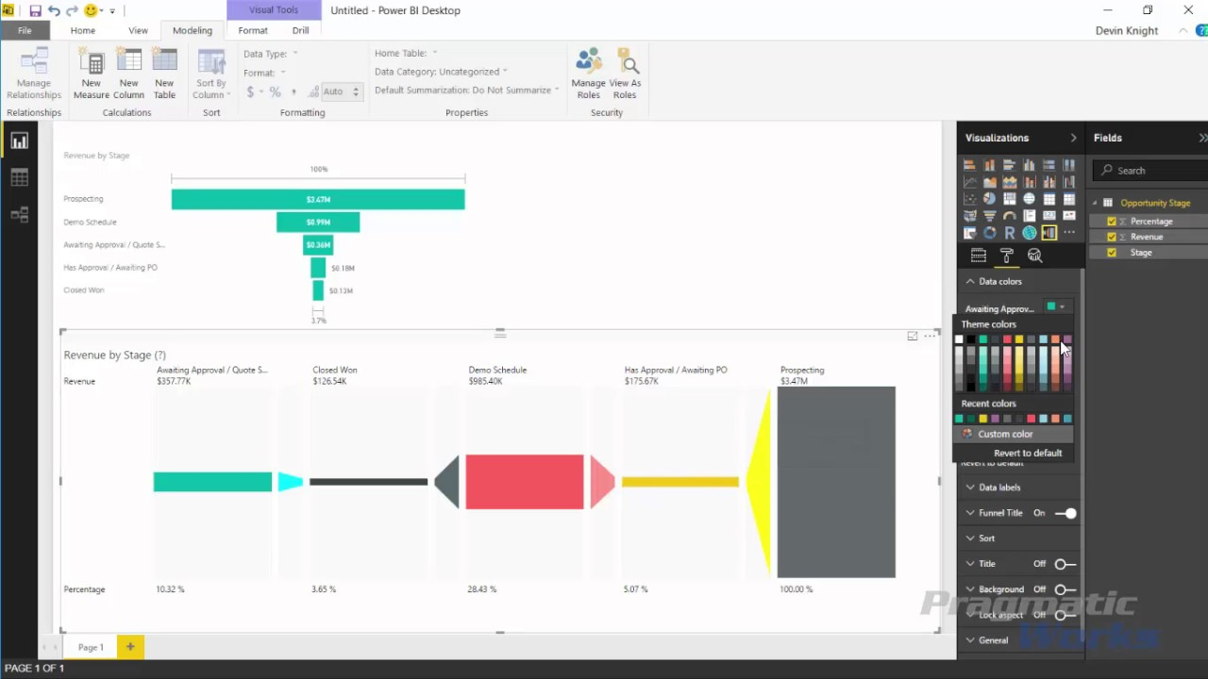
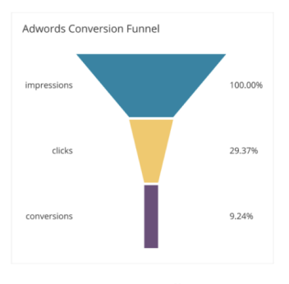
12. Funnel

Slide 17
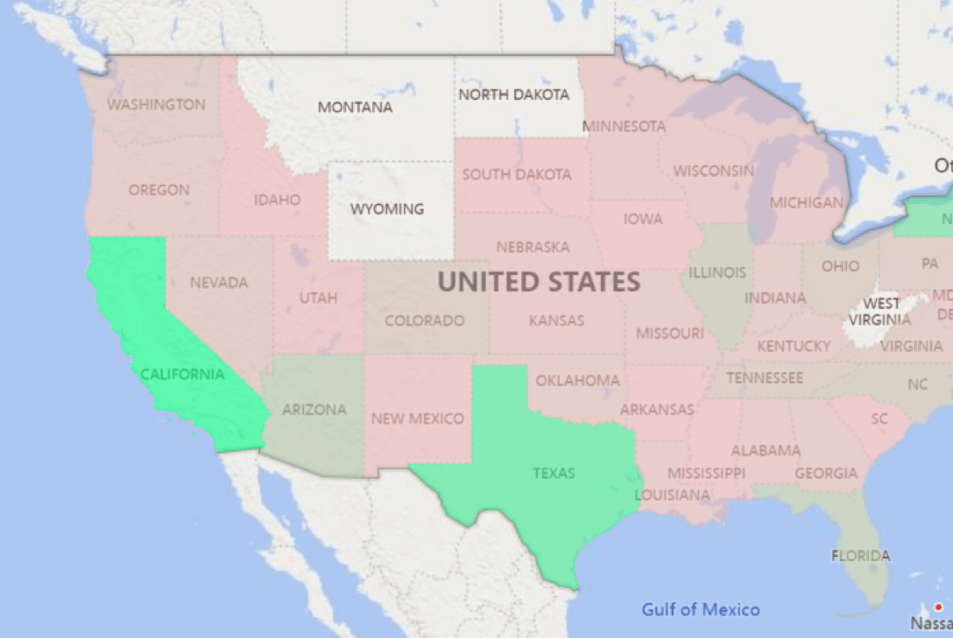
13. Map

Slide 18
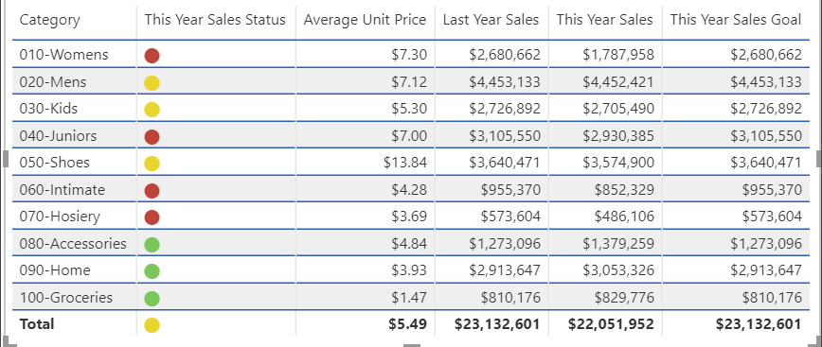
14. Table

Slide 19
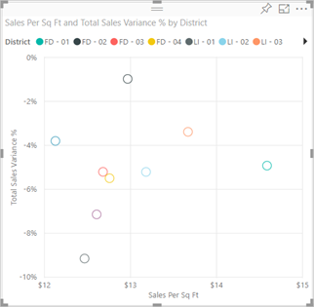
15. Scatter

Slide 20
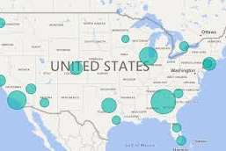
16. Bubble Map

Slide 21
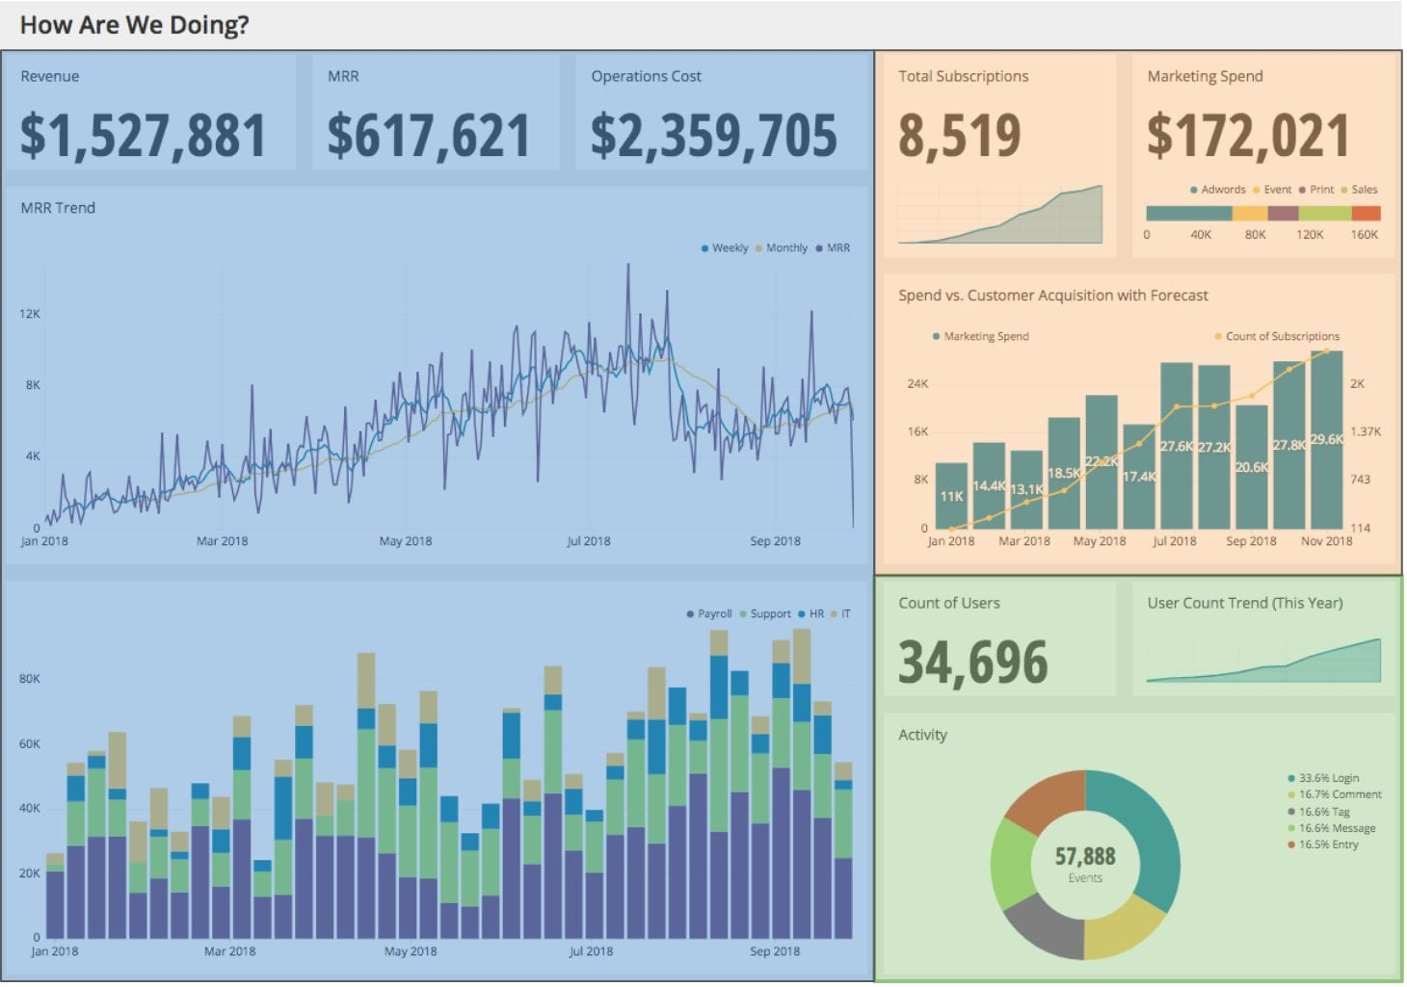
Alignment & Grouping

Slide 22
Characteristics of an useful dashboard
The greatest value of a picture is when it forces us to notice what we never expected to see.
It must have alerts for all the things that could be wrong with the position of businesspeople.
It helps individuals make data-driven decision so they SHOULD see the dashboard regularly.
Accurate, Clear, Empowering and Succinct

Slide 23
CTQ: Accurate
Data Quality: Flagg dashboards in construction and label the last update and its Schedule
Metric Comprehension: Include formulas, notes, or definitions for any non-traditional metric
Visualization Design:
Lines with free y-range to see the variety.
Bar plot y-range start in 0 to compare without confusion.

Slide 24
CTQ: Clear
Fonts: Arial, Helvetica, or Verdana. All text on a dashboard should not require you to squint to read it.
Colors:
Use muted tones (not so bright, for professional look)
The meaning of color should be always the same across the dashboard.
Use traffic light color for important indicators
https://www.youtube.com/watch?v=_JMSw6i5pzY
https://www.youtube.com/watch?v=cWyb9GQbGE4

Slide 25
CTQ: Clear
Colors:
Clear contrast by selecting the correct hue
Use the monochromatic formula when you have many of the same type of data. Darker variation will represent a higher value, and a neutral color (even white) will represent a value closer to zero.
Use complementary with 2 hue for visualizations where you’re showing a transition from (a) one extreme, through a (b) neutral middle, and finally to a (c) opposite extreme.
Use split complementary with 3 hue (Y) for defining contracts
Use Triadic with 3 hue (△) for defining contracts. There are unusual, extreme with primary or secondary colors
Use tetradic with 4 hue (□) for defining contracts. Excellent for the doming of darkest color.
Use Analogous with 3 hue formula for decreasing formula
Transform the hue select form in saturation (transparency) and value (bright) to create more variety.
https://www.youtube.com/watch?v=_2LLXnUdUIc
https://learnui.design/tools/data-color-picker.html#divergent

Slide 26
CTQ: Clear
Context: The target is to create a chart easy to understand.
A descriptive title
Categorical labels
Value labels when it is hard to compare against an axis
Layout:
Set the most important information at the top left.
Visualizations should be aligned by topic if not is because is very important that topic.

Slide 27
CTQ: Empowering
Dashboard´s view:
https://docs.microsoft.com/en-us/power-bi/collaborate-share/service-usage-metrics
https://docs.microsoft.com/en-us/power-bi/collaborate-share/service-modern-usage-metrics
If factor into their decision making:
Ask to end user what charts could generate an immediate decision.

Slide 28
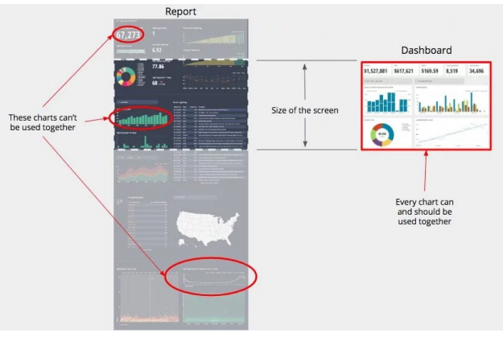
CTQ: Succinct
Keeping it brief and relevant to critical information makes it easy to evaluate all the data simultaneously and make decisions

Slide 29
Process to create a dashboard
Define: To know who this dashboard is for and what metrics matter to them is critical to creating a dashboard that will be used.
Prototype: Define the best way to display them so that it is useful to the whole audience. We need to care about the visualization selected and the way we are going to join all together.
Build: Determinate the data sources that will be used and create de dashboard.
Share: Aggregate any needed context, capacitate for using the dashboard, scaling (optimize queries) and create a process to check all things are working rightly.

Slide 30
Step 1: DEFINE Process
Point Person
Defines the objectives and decisions related.
Director
Defines the priority of the project.
Designer
Helps point person to clarify the definition of the project.
Identifies key metrics.
Identifies the audience.
If it is not hard for them to achieve their goal or they have not tried a solution a new dashboard is unlikely to be valuable to them.

Slide 31
Step 1: DEFINE Getting perspective of the goal and motivation
1. What does success look like?
2. We can understand about the motivation be learning how they are currently solving their problem.
.
• What is the hardest thing about achieving [stated goal]?
• Why is that hard? (Maybe is the process, not the data)
• Can you tell me about a time when you last tried achieving that goal? (I will give you insight into the full process involved)
• How did you overcome the hardest parts? (To borrow the solution)
• What don’t you like about your solution? (For not repeat the same mistake in your dashboard)

Slide 32
Step 1: DEFINE Defining the decisions
1. Best Case Scenario
• How did this happen?
• What decisions did they make in order to achieve their goal?
• What data did they have to make those decisions on?
2. Worst Case Scenario
• How did this happen?
• What bad decisions lead to this outcome?
• What decisions were made with a lack of data?
3. Prioritize the decisions into a rank order with the point person.

Slide 33
Step 1: DEFINE Define the metrics – Conversational Method
Ask to the point person for each decision
What data would help inform that decision?
How else could we improve this decision’s quality?
What other data might be useful?

Slide 34
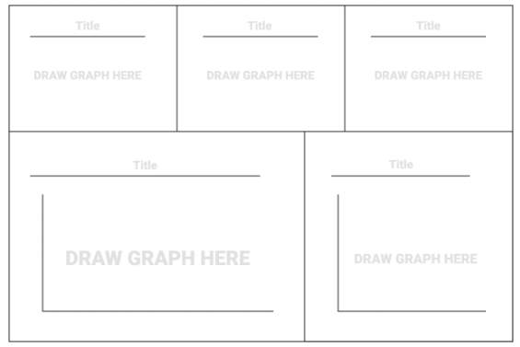
Step 1: DEFINE Define the metrics – visual method

Slide 35
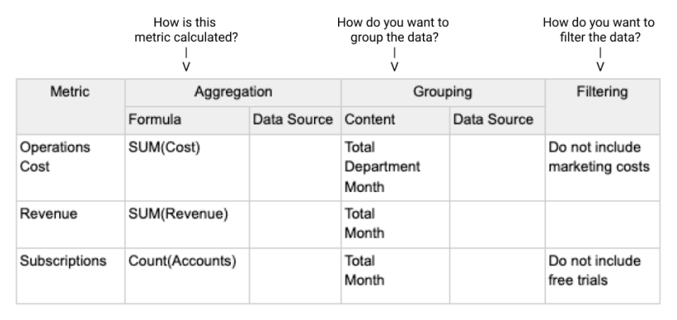
Step 1: DEFINE Define the metrics - metric spreadsheet

Slide 36
Step 2: PROTOTYPE Process
Designer
Point person and audience
Make suggestions to improve the design
Designer
Modificates the prototype
Creates the sketch of the dashboard

Slide 37
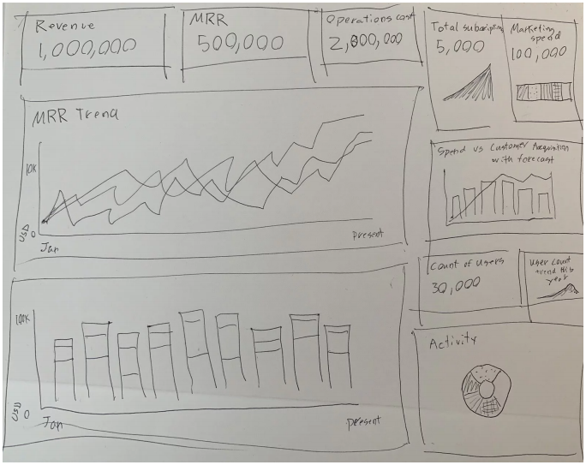
Step 2: PROTOTYPE Sketch

Slide 38

Step 2: PROTOTYPE Suggestions

Slide 39
Step 3: BUILD Process for finding the data
Clean data available
Messy data available
Not data available
Look for the data in database (documentation is the key)
Share the doubts with the Data Gatekeeper
Used as it is with some filters
Correct orthography manually
Not use
Check the quality of data
Study the current process
Design a process to collect new data
Replace values (mean or 0)
Study the current process
Design a process to collect the data
Track where is the historical data
Type or clean data
Track where is the historical data
Type or clean data
Design a process to collect new data
Use Proxy Metrics
Use Proxy Metrics
Design a process to collect the data
Design a process to collect the data

Slide 40
Step 3: BUILD Process for extracting the data
Creates SQL query
Data Gatekeeper
Comporates the query with someone's else related queries
Designer
Checks the queries
Designer
Creates the dashboard assuring the context

Slide 41
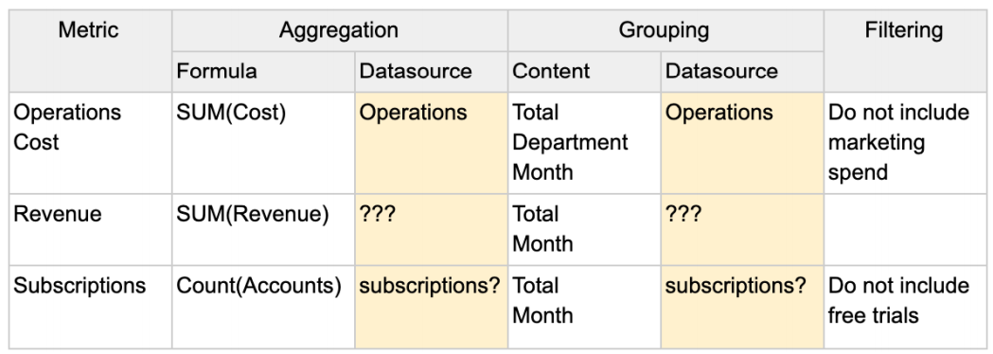
Step 3: BUILD Find data

Slide 42
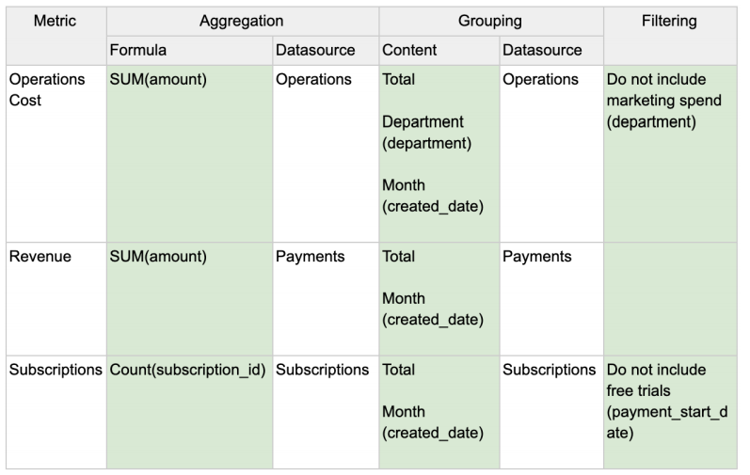
Step 3: BUILD Find data

Slide 43
Step 4: Share Process
Designer
Point person and audience
Make suggestions to improve the design
Designer
Modifies the dashboard
Explains the dashboards to the point person and audience
Optimizes the queries (<=30s)
Designer
Schedules the queries
Sets an automatic email alerts based on some metric.
Links the dashboard with others dashboard
Documents the project
Takes project to production

Slide 44
Other activities
Repair dashboard if something stops of working
Check the views of all dashboards
Check if the current dashboards work correctly
Get feedback after launch

Slide 45
Objetic of project
Create a tool that help me to have an excelente agenda, share my progress with others and automatize my performece as employe.

